Slide 1
C programming

Slide 2
PROGRAMMING LANGUAGE

Slide 3
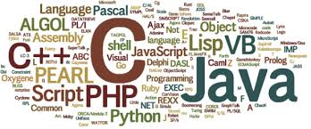
What is Program?
A computer program consists of code that is executed on a computer to perform particular tasks. This code is written by programmers.

Slide 4
Types of languages:
Low level or machine level language --> 0’s, 1’s (binary)
Middle level or assembly language -->
C language
( It also known as the intermediate programming language )
High level language --> human friendly language

Slide 5
History of C Language
C programming language was developed in 1972 by Dennis Ritchie at bell laboratories of AT&T (American Telephone & Telegraph), located in the U.S.A.
Dennis Ritchie is known as the founder of the c language.
It was developed to overcome the problems of previous languages such as B, BCPL, etc.

Slide 6
About C
Mother language
System programming language
Procedure-oriented programming language
Structured programming language
Mid-level programming language

Slide 7
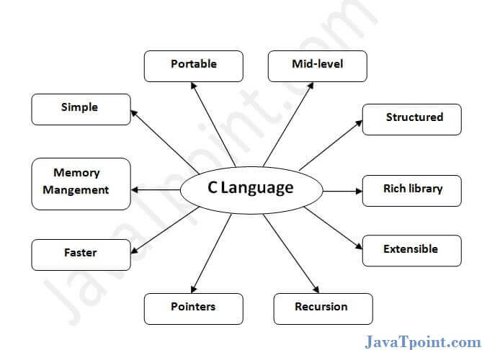
Features of C Language

Slide 8
Compiler in C
A compiler is a special program that translates a programming language's source code into machine code, bytecode or another programming language.

Slide 9
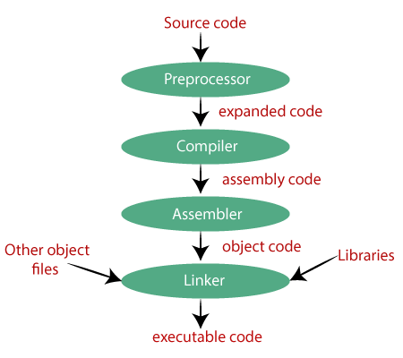
compile stages in c

Slide 10
RUNNING A C PROGRAM
Compiler
Eg: gcc, cc, tcc etc
Integrated Development Environment- IDE (editor, compiler, Debugger)
Eg: visual studio, code blocks etc
Online compilers
Eg: codechef.com, jdoodle.com etc

Slide 11
C Program Structure
Documentations
Pre-processor Statements
Global Declarations
The main() Function
Local Declarations
Program Statements And expressions
User Defined Functions

Slide 12
Program Example
Example:
/* description: writes the words "hello world" on the screen */
#include<stdio.h>
int main()
{
/* first c program */
printf("hello, world!\n");
return 0;
}

Slide 13
Explanation
• /*......*/ - comments
• #include<stdio.h> - pre-processor directive.
• int/void – return value
• main() – main function
• {....} – block
• printf – function to print text to screen
• return 0 – returns value 0 at the end of the main function.

Slide 14
Note
• C requires a semicolon at the end of every statement.
• printf() is a standard C function
• \n signifies newline.

Slide 15
Variables
Variables are Names (identifiers) Associated with locations in memory for storing Variable data.
• Every variable has
Name
Type
Size
Value
Datatype variable=value;

Slide 16
Do’s
1.lower case → ex: a,..,z or name=10
2. uppercase → ex:A,..,Z or NAME=2
3. Both upper and lower → ex: Name=9
4. Underscore (_) max_value=1
5. Variable after number → a=10, a1=3

Slide 17
Don’ts
1.Blank/white space not allowed
2. Keywords not allowed if=10
3.Special symbols (!@#$%^&*)-+:”<>?*/.,;’[]{}| @=3
4.can’t start with digit ex: 1=10, 2agcd=9

Slide 18
Type Modifiers
Size qualifiers
• long
• Short
Sign qualifiers
• Signed
• Unsigned

Slide 19
Data Types
Fundamental Datatypes
• Integer (int)
• Character (char)
• Floating Point (float, double)
User Defined
• TypeDef
• Stucture
• Union
• Enumerated Datatype

Slide 20
Data Type | Memory Size | Range
Char | 1 byte | -128 to 127
Unsigned char | 1byte | 0 to 255
Int | 2 byte | -32,768 to 32,767
Unsigned int | 2 byte | 0 to 65,535
Long int | 4 byte | -2,147,483,648 to 2,147,483,647
Unsigned long int | 4 byte | 0 to 4,294,967,295
Float | 4 byte
Double | 8 byte
Long double | 10 byte

Slide 21
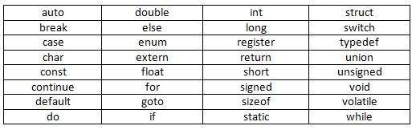
Keywords in C
A keyword is a reserved word. You cannot use it as a variable name, constant name, etc.
There are only 32 reserved words (keywords) in the C language.

Slide 22
Operators
• Special characters used to perform particular operations in C
• Used to manipulate data and variables They are:
Arithmetic Operators
Increment and Decrement Operators
Assignment Operators
Relational Operators
Logical Operators
Conditional Operators
Bitwise Operators
Special Operators

Slide 23
Arithmetic Operators
Arithmetic operators are used to perform addition, subtraction, multiplication, and division.
They act as basic mathematical operations.

Slide 24
Arithmetic Operator Example
#include<stdio.h>
void main(){
int a=10;
int b=5;
printf(“%d”, a+b);//15
printf(“%d”, a-b);//5
printf(“%d”, a*b);//50
printf(“%d”, a/b);//2
printf(“%d”, a%b);//0
}

Slide 25
Assignment Operator
Assignment operator is one of the most common operators. It is used to assign the value on its right to the operand on its left.
Assignment Operator Example
#include<stdio.h>
void main(){
int a=10;
int b=20;
a+=4;//a=a+4 (a=10+4)
b-=4;//b=b-4 (b=20-4)
printf(“%d”,a);
printf(“%d”,b); }

Slide 26
Relational Operators
Operator | Meaning
== | Is equal to
!= | Is not equal to
> | Greater than
< | Less than
>= | Greater than or equal to
<= | Less than or equal to

Slide 27
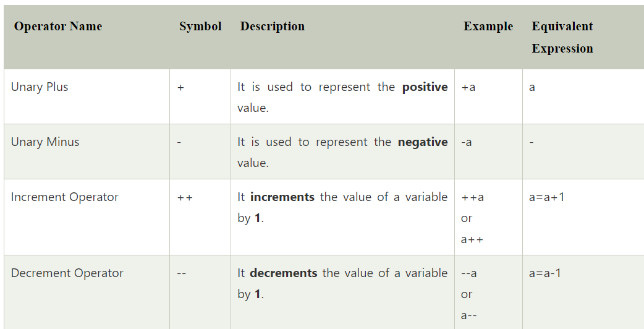
Unary Operators

Slide 28
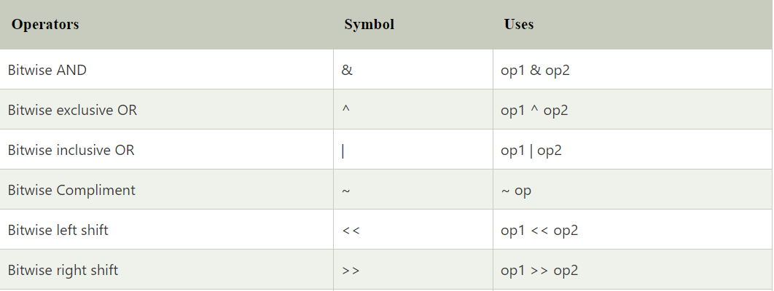
Bitwise Operator

Slide 29
Bitwise AND Bitwise XOR
Bitwise OR Bitwise complement
X | Y | X&Y
0 | 0 | 0
0 | 1 | 0
1 | 0 | 0
1 | 1 | 1
X | Y | X^Y
0 | 0 | 0
0 | 1 | 1
1 | 0 | 1
1 | 1 | 0
X | Y | X|Y
0 | 0 | 0
0 | 1 | 1
1 | 0 | 1
1 | 1 | 1
X | ~X
0 | 1
1 | 0

Slide 30
Shift Operators
Left Shift Operator (<<)
Right Shift Operator (>>)
Left Shift Operator (<<)
The signed left shift operator (<<) shifts a bit pattern to the left. It is represented by the symbol <<.
It also preserves the leftmost bit (sign bit). It does not preserve the sign bit.

Slide 31
Right Shift Operator (>>)
The leftmost position after >> depends on the sign bit. It does not preserve the sign bit.

Slide 32
Logical operators
Logical operators are generally used for combining two or more relational statements. They return Boolean values.
&& (Logical AND)
The logical && operator doesn't check the second condition if first condition is false. It checks the second condition only if the first one is true.

Slide 33
|| (Logical OR)
The Logical OR operator is represented with the two vertical line symbols.
It works opposite to the logical AND operator, as it only gives false when both statements of the expression are not true. Otherwise, it returns true.

Slide 34
! (Logical NOT operator)
This logical operator is represented as an exclamation sign (!). This operator accepts a single argument and returns the inverse value of the corresponding argument.

Slide 35
Conditional (Ternary) Operator
In C, the ternary operator is a conditional operator.
The meaning of ternary is composed of three parts.
The ternary operator (? :) consists of three operands.
It is used to evaluate Boolean expressions.
Syntax:
variable = (condition) ? expression1 : expression2

Slide 36
Special Operators
Comma Operator
• Link related expressions togather
• Eg: int a, c = 5, d;
Sizeof Operator
• returns the size of data
• Eg:
int a,b;
b=sizeof(a);
&- Address of Operator
Eg: &a;
- Pointer to a variable
Eg: * a

Slide 37
Control statements

Slide 38
Flow of control
Sequential statements
Selectional/Conditional statements
Loop/Iterative/Repeatation statements
Jumping/transfer statements

Slide 39
Control statements
It controls the flow of a program.
A control statement in C is a statement
that determines whether the other statements will be executed or not.

Slide 40
If statement
if statement to specify a block of C code to be executed if a condition is true.
Syntax:
if (condition) {
// block of code to be executed if the condition is true }
Real time Example:
If there is raining , we will not play in the ground

Slide 41
If else statement
else statement to specify a block of code to be executed if the condition is false.
Syntax:
if (condition) {
// block of code to be executed if the condition is true}
else {
// block of code to be executed if the condition is false
}
Real time Example
If there is raining . we will not play in the ground,else
We will play in the ground.

Slide 42
Else if statement
else if statement to specify a new condition if the first condition is false.
Syntax:
if (condition1) {
// block of code to be executed if condition1 is true } else if (condition2) {
// block of code to be executed if the condition1 is false and condition2 is true }
else {
// block of code to be executed if the condition1 is false and condition2 is false }
Real time Example:
Student mark system , Income tax payment.

Slide 43
Nested if statement
The nested if statement represents the if block within another if block.
Here, the inner if block condition executes only when outer if block condition is true.
Syntax:
if(condition){
//code to be executed
if(condition){
//code to be executed
} }
Real Time Example:
Blood Donation conditions.

Slide 44
switch statement
The switch statement executes one statement from multiple conditions. It is like if-else-if ladder statement.
Syntax
switch(expression){
case value1:
//code to be executed;
break; //optional
default:
code to be executed if all cases are not matched; }

Slide 45
Loop/Iterative/Repeatation statements
Loops is used to execute a particular part of the
program repeatedly , if a given condition evaluates to be true.
For example,
You put your favorite song on a repeat mode. It is also a loop.
Software of the ATM machine is in a loop to process transaction after
transaction until you acknowledge that you have no more to do.

Slide 46
Types of loops
There are three types of loop
for loop\Entry check loop
While loop\Entry check loop
Do while loop\Exist check loop

Slide 47
for Loop
Syntax:
for(initialization; condition; increment/decrement)
{
//statement or code to be executed
}

Slide 48
for loop have 5 types
for loop using increment
for loop using decrement
for loop using infinity
Nested for loop

Slide 49
While Loop
Syntax
while (condition){
//code to be executed
Increment / decrement statement
}

Slide 50
Types of While loop
While loop using Increment
While loop using decrement
Infinity while loop

Slide 51
do-while Loop
If the number of iteration is not fixed and you must have to execute the loop at least once, it is recommended to use a do-while loop.
Syntax:
do
{
//code to be executed / loop body
//update statement
}while (condition);

Slide 52
Transfer or Jumping Statements
Jumping statements are control statements that transfer execution control from one point to another point in the program.
break statement.
continue statement.
goto statement.

Slide 53
Break Statement
The C break statement is used to break loop or switch statement. It breaks the current flow of the program at specified condition.
In case of inner loop, it breaks only inner loop.
Syntax:
jump-statement;
break;

Slide 54
Continue Statement
The C continue statement is used to continue the loop.
It continues the current flow of the program and skips the remaining code at the specified condition.
In case of an inner loop, it continues the inner loop only.
Syntax:
jump-statement;
continue;

Slide 55
goto Statement
The goto statement is known as jump statement in C.
As the name suggests, goto is used to transfer the program control to a predefined label.
The goto statment can be used to repeat some part of the code for a particular condition

Slide 56
Example
#include <stdio.h>
int main()
{
printf("hi\n");
goto kokila;
printf("ga\n");
kokila:printf("bye");
}

Slide 57
Arrays in c
An array is defined as the collection of similar type of data items stored at contiguous memory locations.
int Numbers[] = {90, 50, 60, 100}; To access an array element, refer to its index number.
Array indexes start with 0: [0] is the first element. [1] is the second element, etc

Slide 58
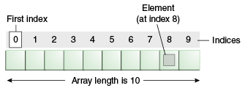
An array is a container object that holds a fixed number of values of a single type. The length of an array is established when the array is created. After creation, its length is fixed.
Real time Example:
Mobile number saving.
Show room.

Slide 59
Advantages
Code Optimization: It makes the code optimized, we can retrieve or sort the data efficiently.
Random access: We can get any data located at an index position.
Disadvantages
Size Limit: We can store only the fixed size of elements in the array. It doesn't grow its size at runtime.

Slide 60
Types of Array in java
There are two types of array.
Single Dimensional Array
Multidimensional Array
Declaring an array
Single Dimensional Array
int a[] = {25, 50, 75, 100};
Multidimensional Array
int a[][] = {{25, 50, 7},{10,20,5}};

Slide 61
Single dimensional array
void main(){
int a[5];
a[0]=10;//initialization
a[1]=20;
a[2]=70;
for(int i=0;i<4;i++)
{
printf(“%d”,a[i]);
}}

Slide 62
Multidimensional Array
void main(){
int arr[][]={{1,2,3},{2,4,5},{4,4,5}};
//printing 2D array
for(int i=0;i<3;i++){
for(int j=0;j<3;j++){
printf(“%d”,arr[i][j]); }
printf(“\n”);
} }

Slide 63
Functions in c

Slide 64
What is Functions?
The function or method is a collection of instructions that performs a specific task.
You can pass data, known as parameters, into a method.
Function is a block of code which runs only it is called .
Real time Example:
Switch have two functions ,that is on() and off().

Slide 65
Why Functions?
It provides the reusability of code.
It also provides the easy modification and readability of code, , just by adding or removing a chunk of code.
Function are useful in hiding the implementation details.
It is easier to edit a program, which is written using methods

Slide 66
Syntax for functions
Return –type function name(datatype variable/arguments)
{
Function body;
}

Slide 67
Types of Functions
There are Four types of methods in Java:
Predefined Method
User-defined Method
Return Method
Recursive Method

Slide 68
Predefined Method
It is also known as the standard library method or built-in method.
Some pre-defined methods are length(), equals(), compareTo(), sqrt(), etc.

Slide 69
User-defined Method
The method written by the user or programmer is known as a
user-defined method.
These methods are modified according to the requirement.
It is 4 types
Function with argument , with return value.
Function with argument , without return value.
Function without argument , with return value.
Function without argument , without return value.

Slide 70
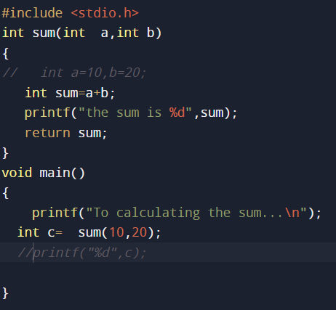
Function with argument , with return value.

Slide 71
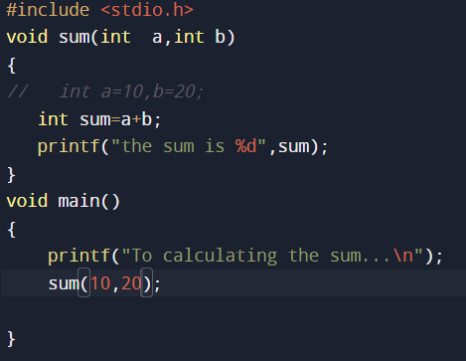
Function with argument , without return value.

Slide 72
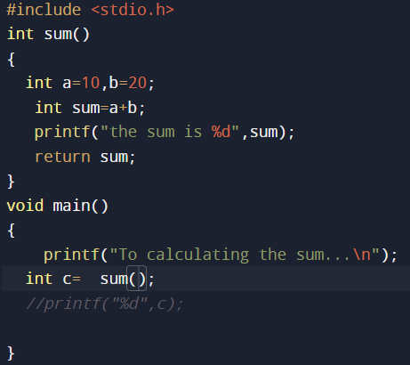
Function without argument , with return value.

Slide 73
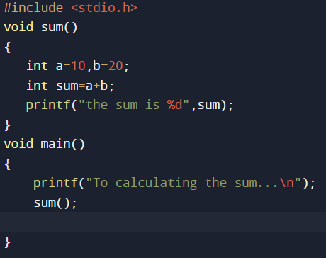
Function without argument , without return value.

Slide 74
Recursion in C
Recursion in java is a process in which a method calls itself continuously.
A method in java that calls itself is called recursive method.
Syntax:
Return type method name(){
Method name();//calling same method
}

Slide 75
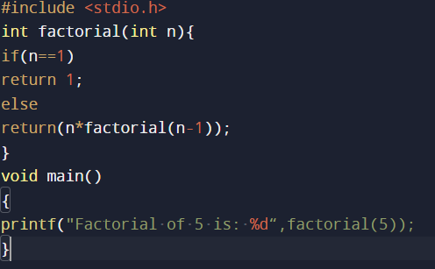
Example Program To find factorial of given number.

Slide 76
Strings in c
The string can be defined as the one-dimensional array of characters terminated by a null ('\0’).
Each character in the array occupies one byte of memory, and the last character must always be 0.
The termination character ('\0') is important in a string since it is the only way to identify where the string ends.

Slide 77
There are two ways to declare a string in c language.
By char array
By string literal

Slide 78
Declaring string by char array
char ch[10]={‘H', ’e', ’l', ’l', ’o', ’C', '\0'};
2. String by the string literal
char ch[]=“HelloC";
In such case, '\0' will be appended at the end of the string by the compiler.

Slide 79
Accepting string as the input
Till now, we have used scanf to accept the input from the user.
Consider the below code which stores the string while space is encountered.
#include<stdio.h>
void main ()
{ char s[20];
printf("Enter the string?");
scanf("%s",s);
printf("You entered %s",s);
}

Slide 80
C gets() and puts() functions
The gets() and puts() are declared in the header file stdio.h. Both the functions are involved in the input/output operations of the strings.
gets() function
The gets() allows the user to enter the space-separated strings. It returns the string entered by the user.

Slide 81
puts() function
The puts() function is very much similar to printf() function.
The puts() function is used to print the string on the console which is previously read by using gets() or scanf() function.
#include<stdio.h>
#include <string.h>
int main(){
char name[50];
printf("Enter your name: ");
gets(name); //reads string from user
printf("Your name is: ");
puts(name); //displays string
return 0; }

Slide 82
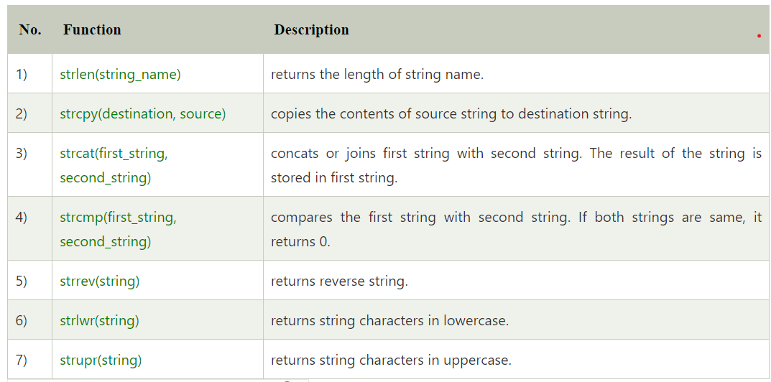
String Functions

Slide 83
else{ printf("The strings are not equal\n"); } printf("The reversed string is..%s\n",strrev(s)); printf("The lower string is %s\n",strlwr(s)); printf("The upper string is %s\n",strupr(s)); char *sub; char a[25]="I love my family"; sub=strstr(a,"my"); printf("the sub string is..%s",sub); }
Example
#include<stdio.h>
void main()
{
char s[50]="kokila";
char s1[25]="Janarthanan";
printf("The length of the string is %d\n",strlen(s1));
char s2[10];
strcpy(s2,s1);
printf("The copied string is..%s\n",s2);
strcat(s,s2);
printf("The concated string is..%s\n",s);
if(strcmp(s,s1)==0) { printf("The strings are equal\n"); }

Slide 84
Pointers
The pointer in C language is a variable which stores the address of another variable.
Consider the following example to define a pointer which stores the address of an integer.
int n = 10;
int* p = &n; // Variable p of type pointer is pointing to the address of the variable n of type integer.

Slide 85
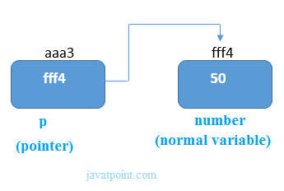
Declaring a pointer
The pointer in c language can be declared using * (asterisk symbol). It is also known as indirection pointer used to dereference a pointer.
int *a;//pointer to int
char *c;//pointer to char

Slide 86
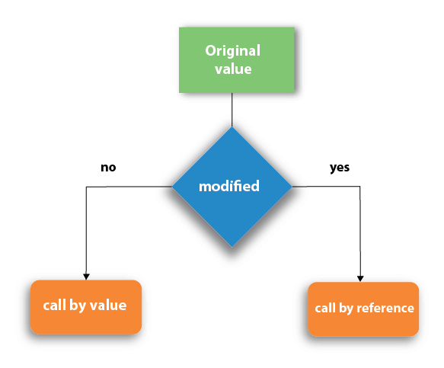
Call by value and Call by reference in C
There are two methods to pass the data into the function in C language, i.e., call by value and call by reference.

Slide 87
Call by value in C
In call by value method, the value of the actual parameters is copied into the formal parameters. In other words, we can say that the value of the variable is used in the function call in the call by value method.
In call by value method, we can not modify the value of the actual parameter by the formal parameter.

Slide 88
#include<stdio.h>
void change(int num) {
printf("Before adding value inside function num=%d \n",num);
num=num+100;
printf("After adding value inside function num=%d \n", num);
}
int main() {
int x=100;
printf("Before function call x=%d \n", x);
change(x);//passing value in function
printf("After function call x=%d \n", x);
return 0;}

Slide 89
Call by reference in C
In call by reference, the address of the variable is passed into the function call as the actual parameter.
The value of the actual parameters can be modified by changing the formal parameters since the address of the actual parameters is passed.
In call by reference, the memory allocation is similar for both formal parameters and actual parameters.

Slide 90
Example
include<stdio.h>>
void main()
{
int a=10,b=20;
printf("Before Swaping the numbers are %d,%d\n",a,b);
swap(&a,&b);
printf("After swaping values are..%d ,%d",a,b); }
void swap(int *x,int* y)
{
*x=*x+*y;
*y=*x-*y;
*x=*x-*y;}

Slide 91
Declaration of Constants in C
2 Ways:
• Using const keyword in variable declaration.
• Using #define preprocessor directives.

Slide 92
Declaration of Constants in C
1. Constant variable
• Syntax
const data_type variable_name = Constant;
• Example
const float PI = 3.141;

Slide 93
#define preprocessor directives.
• Syntax
#define Constant_Identifier Value
• Example:
#define PI 3.141

Slide 94
Storage Classes
Storage classes in C are used to determine the lifetime, visibility, memory location, and initial value of a variable. There are four types of storage classes in C
Automatic
External
Static
Register

Slide 95
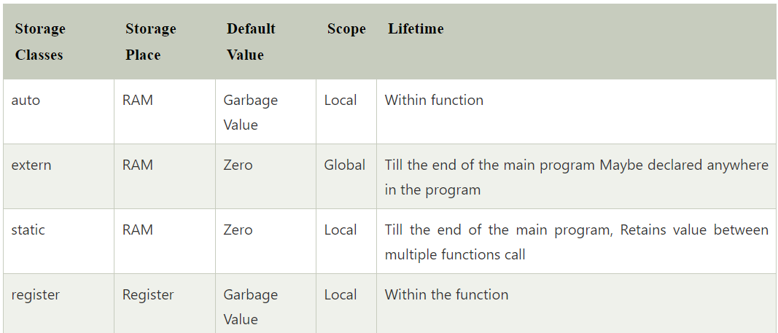

Slide 96
Structure in c

Slide 97
What is Structure
Structure in c is a user-defined data type that enables us to store the collection of different data types.
Each element of a structure is called a member. simulate the use of classes and templates as it can store various information
The ,struct keyword is used to define the structure.

Slide 98
Let's see the syntax to define the structure in c.
struct structure_name
{
data_type member1;
data_type member2;
data_type memeberN;
};

Slide 99
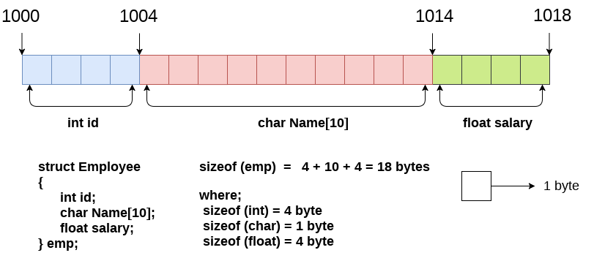

Slide 100
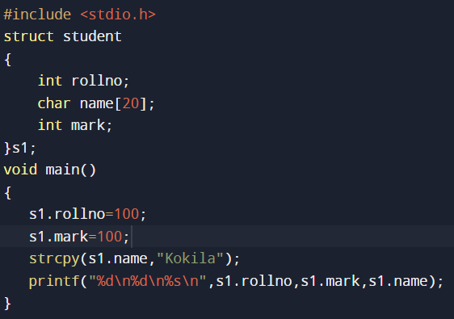
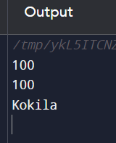

Slide 101
Union in C
Union can be defined as a user-defined data type which is a collection of different variables of different data types in the same memory location.
When we define the union, then we found that union is defined in the same way as the structure is defined but the difference is that union keyword is used for defining the union data type, whereas the struct keyword is used for defining the structure.

Slide 102
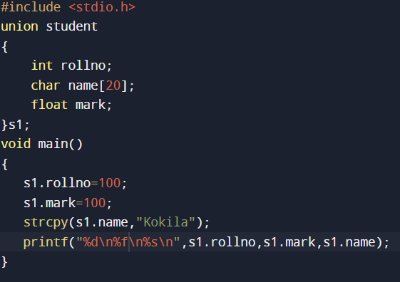
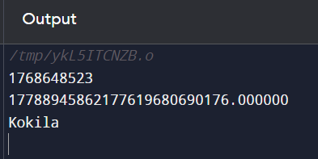

Slide 103
Enum in C
The enum in C is also known as the enumerated type.
It is a user-defined data type that consists of integer value.
It provides meaningful names to these values.
The use of enum in C makes the program easy to understand and maintain.
The enum is defined by using the enum keyword.

Slide 104
Enumerated type declaration
We need to declare the variable of a pre-defined type such as int, float, char, etc.
Similarly, we can declare the variable of a user-defined data type, such as enum.
enum fruits{mango, apple, strawberry, papaya};
enum fruits{
mango=2,
apple=1,
strawberry=5,
papaya=7,
};

Slide 105
Example
#include <stdio.h>
enum weekdays{Sunday=1, Monday, Tuesday, Wednesday, Thursday,
Friday, Saturday};
int main()
{
enum weekdays w; // variable declaration of weekdays type
w=Monday; // assigning value of Monday to w.
printf("The value of w is %d",w);
return 0;
}

Slide 106
typedef in C
The typedef is a keyword used in C programming to provide some meaningful names to the already existing variable in the C program.
It behaves similarly as we define the alias for the commands.
In short, we can say that this keyword is used to redefine the name of an already existing variable.
Syntax of typedef
typedef <existing_name> <alias_name>

Slide 107
Example
#include <stdio.h>
int main()
{
typedef unsigned int unit;
unit i,j;
i=10;
j=20;
printf("Value of i is :%d",i);
printf("\nValue of j is :%d",j);
return 0;
}

Slide 108
C Preprocessor Directives
The C preprocessor is a micro processor that is used by compiler to transform your code before compilation.
It is called micro preprocessor because it allows us to add macros.

Slide 109
All preprocessor directives starts with hash # symbol.
Let's see a list of preprocessor directives.
#include
#define
#undef
#ifdef
#ifndef
#if
#else
#elif
#endif
#error
#pragma

Slide 110
#include
the use of #include directive, we provide information to the preprocessor where to look for the header files. There are two variants to use #include directive.
#include directive example
#include<stdio.h>
int main(){
printf("Hello C");
return 0;
}

Slide 111
#define
The #define preprocessor directive is used to define constant or micro substitution. It can use any basic data type.
Syntax:
#define token value
Let's see an example of #define to define a constant.
#include <stdio.h>
#define PI 3.14
main() {
printf("%f",PI);
}

Slide 112
#undef
The #undef preprocessor directive is used to undefine the constant or macro defined by #define.
Syntax:
#undef token
Let's see a simple example to define and undefine a constant.
#include <stdio.h>
#define PI 3.14
#undef PI
main() {
printf("%f",PI);
}

Slide 113
#ifdef
The #ifdef preprocessor directive checks if macro is defined by #define. If yes, it executes the code otherwise #else code is executed, if present.
Syntax:
#ifdef MACRO
//code
#endif

